Slide 1
Hash Tables I

Slide 2




HELLO!
• My name’s Mari
• Software Engineer for 6 years
• Currently an engineer in FB Dating
• Previously at Apple, Coursera
• You’re stuck with me for Unit 2!

Slide 3
AGENDA
• Intro to Hash Tables
• UPER
• Hash Tables & Interviews
• Ask questions on the Slack thread

Slide 4
Intro to Hash Tables

Slide 5
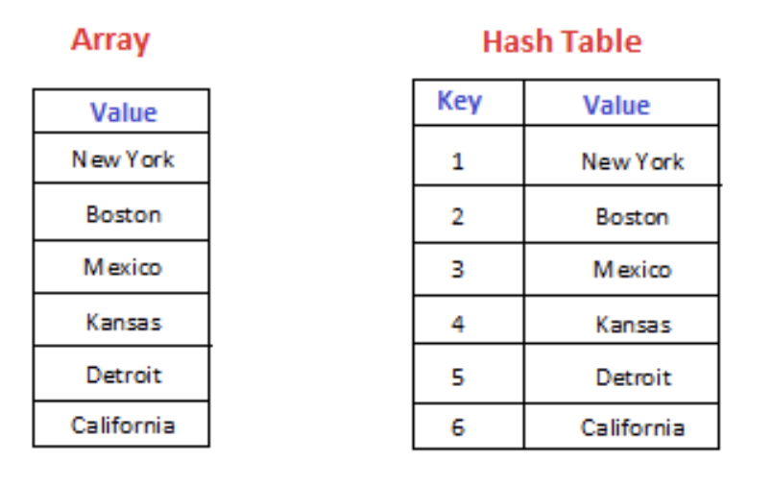
INTRO TO HASH TABLES
• Problem: Searching for an element in a list is O(n)
• Solution: Hash tables allows for O(1) lookup
• One of the most common data structures
• Key concept: Use a hashing function to get/store/delete values in O(1) time
Notes:
• Problem: Searching for an element in a list is O(n)
You all have probably used a list to keep track of things. The problem with lists is that in order to get the element you want, you need to traverse the entire list in the worst case
• Solution: Hash tables allows for O(1) lookup
Hash tables allow you to get values in constant time, which is much faster
• One of the most common data structures
A lot of data structures actually make use of hash tables underneath the hood: Sets, Dictionaries, Tries
This is used a lot in the industry: databases, caches and many more
Also a very common data structure that is used in interviews
It’s so popular that an interview may even ask you how a hash table works underneath the hood

Slide 6
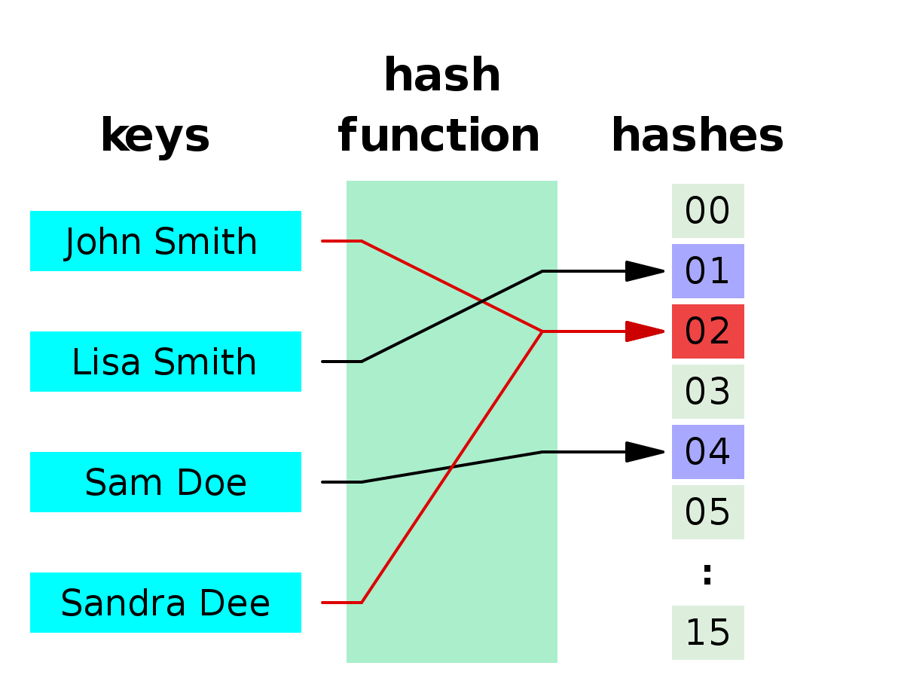
HASH FUNCTIONS
• Takes an input string and returns an index/number
• Main characteristics:
• Deterministic - same input should always result in the same output
• Minimal duplication of output values - to minimize collisions, we’ll talk about this in the next lecture
• Fast - getting the hash must be O(1)

Slide 7
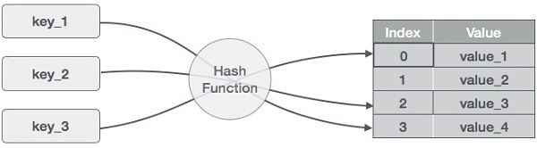
HASH FUNCTIONS IN HASH TABLES
• A hash table uses a hash function to get/store/delete values in O(1) time
• A hash table uses a list to store values
• Run the input string/key through the hash function
• Use the modulo operator to get an index within the array bounds
• Get/store/delete the value at that index

Slide 8
WHY’S IT CALLED A HASH FUNCTION?
• “To hash means to chop something up or to make a mess out of it; the idea in hashing is to scramble some aspects of the key and to use this partial information as the basis for searching.” - Donald Knuth
• We’re scrambling the input string and turning it into a number
• We use that number to get/store/delete values in the hash table

Slide 9
Live Coding: A Basic Hash Function

Slide 10
LIVE CODING: SUMMARY
• To Put:
• Run key string through the hash function to get the hash value
• Mod the hash value with the table size to get the index
• Store the value at the index
• To Get:
• Run key string through the hash function to get the hash value
• Mod the hash value with the table size to get the index
• Return the value at the index

Slide 11
HASH TABLE: TIME COMPLEXITIES
• Get: O(1)
• Store: O(1)
• Delete: O(1)
• This is amortized/averaged over time. Worst case is actually O(n) and we’ll talk about why in the next lecture!

Slide 12
FOR YOUR PROJECT...
• Implement a hash table class that can get/store/delete values
• Use the DJB2, FNV-1 hashing algorithm
• Hints for implementing DJB2
• Note: Don’t worry about collisions yet

Slide 13
Other Uses of Hash Functions

Slide 14

OTHER USES OF HASH FUNCTIONS
• Used widely in cryptography
• SHA-256 encryption algorithm
• Used for the most popular authentication and encryption protocols (SSL, TLS, etc.)
• Also used in cryptocurrencies such as Bitcoin
• Used to verify transactions, create addresses, etc.

Slide 15
UPER

Slide 16
UPER
• A general framework for solving problems
• Understand, Plan, Execute, Review
• Very useful for this unit and in programming interviews

Slide 17
ALGORITHMIC AND DATA STRUCTURE INTERVIEWS
• You’ll definitely encounter algorithmic and data structure interviews during your job search
• Typical outline of an algorithmic/data-structure interview: 5 minute intro, 40-ish minutes of coding (1-2 problems)

Slide 18
WHY USE UPER FOR INTERVIEWS?
• Getting the optimal answer is just one of the many things an interviewer looks for
• They also look for: thought process, testing, spotting bugs, communication skills, coding speed
• UPER allows you to demonstrate this in interviews
• Helps keep you calm during interviews

Slide 19
UNDERSTAND
• Really get to know what the problem is asking for
• Create test-cases: you will use this to convince yourself and the interviewer your answer is correct
• This step could also help you develop a solution

Slide 20
PLAN
• This is usually the part that takes the most time
• What patterns have you seen before that you can apply to the problem?
• What techniques could I use? What data structures can I use? Can I find a better solution? What helper methods do I need?
• Do NOT proceed to the next step unless you know what you’re going to code

Slide 21
EXECUTE
• Code your algorithm!
• If you prepare properly, this should be the easiest/fastest step
• Watch out for bugs

Slide 22
REVIEW
• Give your code a pass through and correct any bugs
• Make sure you don’t cause regressions when fixing your bugs
• Test your code with the test cases you made in the Understand step
• State your runtime and space complexity

Slide 23
Hash Tables & Interviews

Slide 24
HASH TABLES: THINGS TO KNOW
• There’s many use-cases for hash-tables in programming problems
• Hash-and-store: Use O(1) get/store/delete operations in dictionaries/sets to solve the problem faster, at the expense of additional space

Slide 25
JEWELS AND STONES
• Return how many stones are jewels
• Leetcode Link

Slide 26
Jewels and Stones Demo

